Slide 1
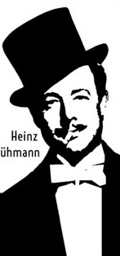
Feuerzangenbowle
Physics of Imbibition and Porous Media Flow
Manuel Lippert
Physik (Master of Science)

Slide 2
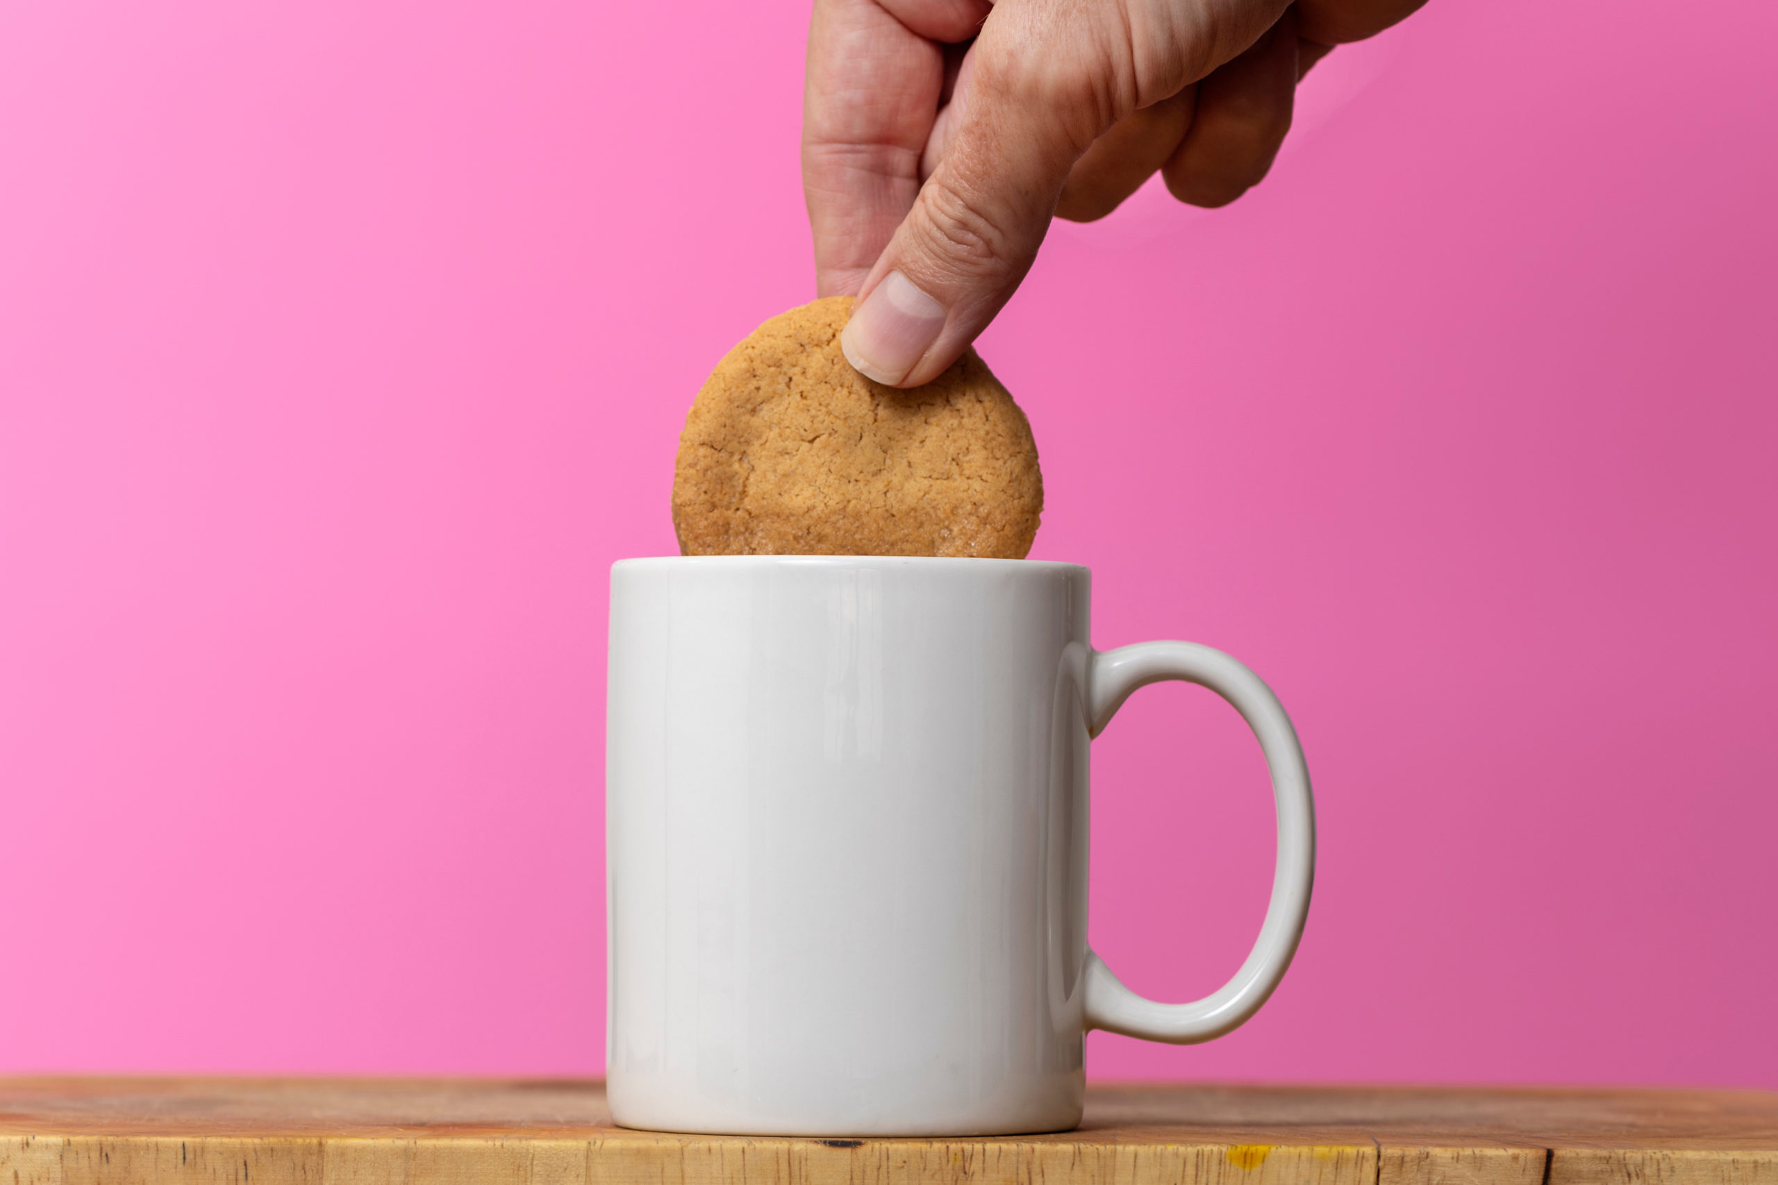

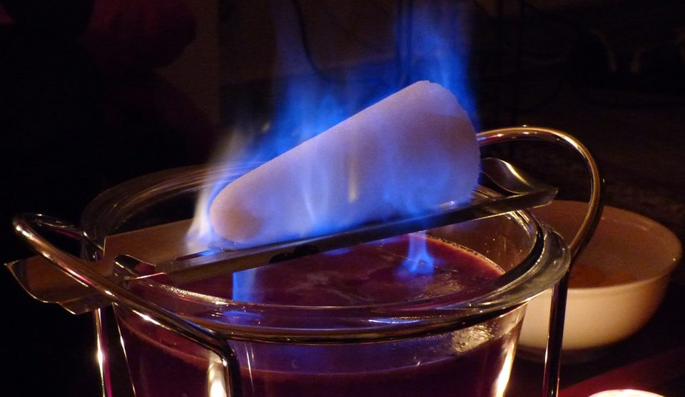
WHAT IS IMBIBITION?
1
Motivation

Slide 3
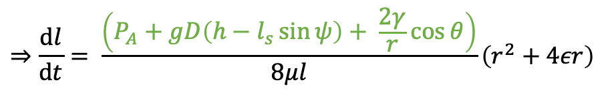

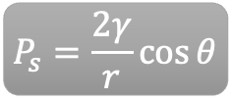
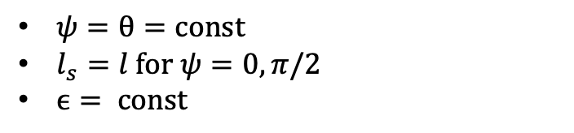
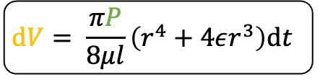
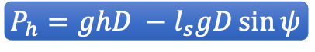

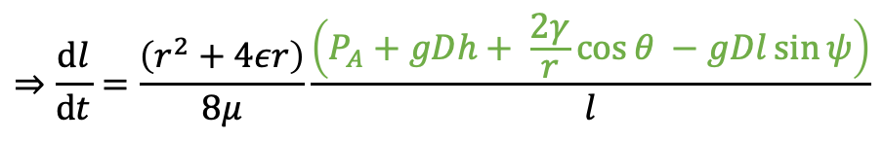

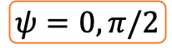
IMBIBITION AND DYNAMICS OF CAPILLARY FLOW
2
Theory
E. W. Washburn (1921) “The dynamics of capillary flow“
$$P_{h}=ghD −l_{s}gD\sin{ψ}$$
$$P_{s}=\frac{2γ}{r}\cos{θ}$$
$$P_{A}=\text{const}$$
$$P=P_{A}+P_{h}+P_{s}$$
$$\text{d}V= \frac{πP}{8μl}\left(r^{4}+4εr^{3}\right)\text{d}t$$
Poiseuille‘s Law
$$\text{d}V=πr^{2}\text{d}l$$
$ψ=θ=\text{const}$
$l_{s}=l \text{for} ψ=0,π/2$
$ϵ= \text{const}$
$$⇒\frac{\text{d}l}{\text{d}t}= \frac{\left(P_{A}+gD\left(h−l_{s}\sin{ψ}\right)+ \frac{2γ}{r}\cos{θ}\right)}{8μl}\left(r^{2}+4εr\right)$$
$$⇒\frac{\text{d}l}{\text{d}t}=\frac{\left(r^{2}+4εr\right)}{8μ}\frac{\left(P_{A}+gDh+ \frac{2γ}{r}\cos{θ −gDl\sin{ψ}}\right)}{l}$$
$$ψ=0, π/2$$

Slide 4
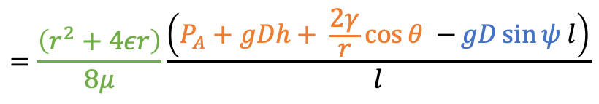
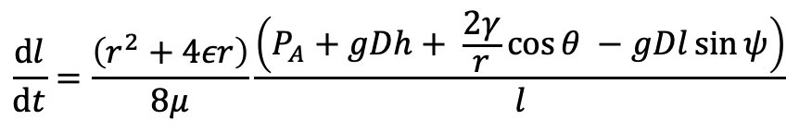
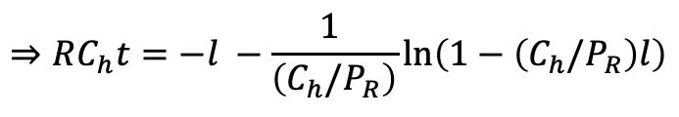
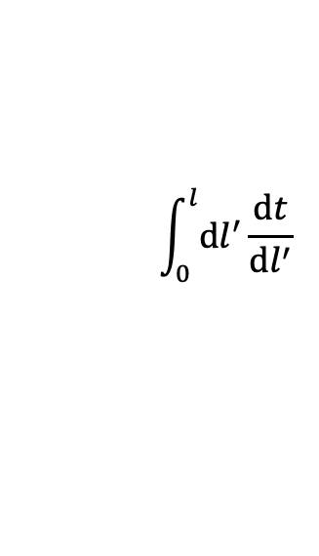
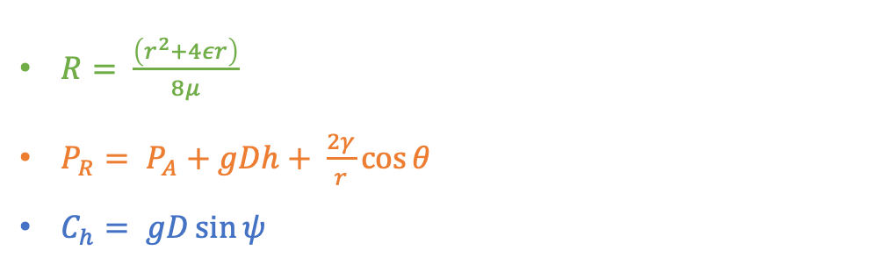
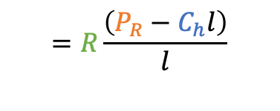
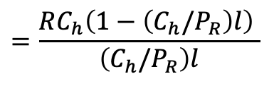
IMBIBITION AND DYNAMICS OF CAPILLARY FLOW
2
Theory
E. W. Washburn (1921) “The dynamics of capillary flow“
$$\frac{\text{d}l}{\text{d}t}=\frac{\left(r^{2}+4εr\right)}{8μ}\frac{\left(P_{A}+gDh+ \frac{2γ}{r}\cos{θ −gDl\sin{ψ}}\right)}{l}$$
$$=\frac{\left(r^{2}+4εr\right)}{8μ}\frac{\left(P_{A}+gDh+ \frac{2γ}{r}\cos{θ −}gD\sin{ψ l}\right)}{l}$$
$$=R\frac{\left(P_{R}−C_{h}l\right)}{l}$$
$$=\frac{RC_{h}\left(1−\left(C_{h}/P_{R}\right)l\right) }{\left(C_{h}/P_{R}\right)l}$$
$ψ=θ=\text{const}$
$l_{s}=l \text{for} ψ=0,π/2$
$ϵ= \text{const}$
$$\int_{0}^{l}{\text{d}l^{′}}\frac{\text{d}t}{\text{d}l^{′}}$$
$$⇒RC_{h}t=−l −\frac{1 }{\left(C_{h}/P_{R}\right)}\text{ln}\left(1−\left(C_{h}/P_{R}\right)l\right)$$
$R= \frac{\left(r^{2}+4εr\right)}{8μ}$
${P_{R}= P}_{A}+gDh+ \frac{2γ}{r}\cos{θ }$
$C_{h}= gD\sin{ψ }$

Slide 5
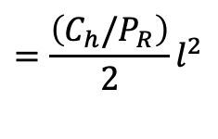
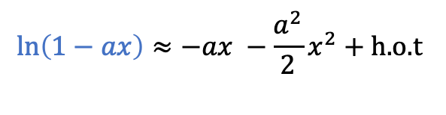
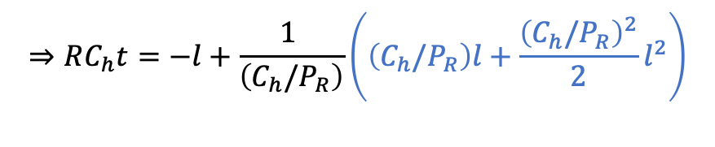
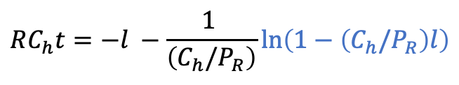
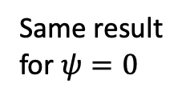
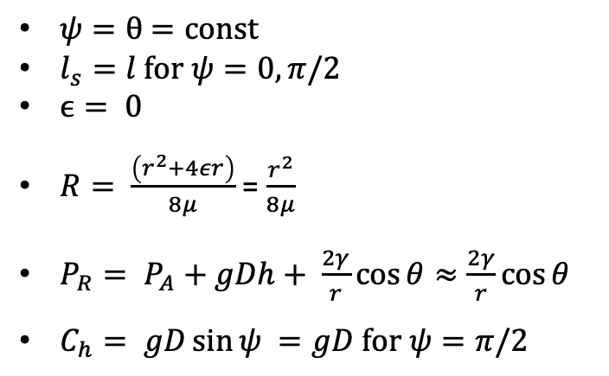
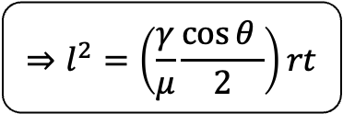
IMBIBITION AND DYNAMICS OF CAPILLARY FLOW
2
Theory
E. W. Washburn (1921) “The dynamics of capillary flow“
$$RC_{h}t=−l −\frac{1 }{\left(C_{h}/P_{R}\right)}\text{ln}\left(1−\left(C_{h}/P_{R}\right)l\right)$$
$$\text{ln}\left(1−ax\right)≈−ax −\frac{a^{2}}{2}x^{2}+\text{h}\text{.}\text{o}\text{.}\text{t}$$
$$⇒RC_{h}t=−l+\frac{1 }{\left(C_{h}/P_{R}\right)}\left(\left(C_{h}/P_{R}\right)l+\frac{{\left(C_{h}/P_{R}\right)}^{2}}{2}l^{2}\right)$$
$ψ=θ$ $=\text{const}$
$l_{s}=l \text{for} ψ=0,π/2$
$ϵ= \text{0}$
$R= \frac{\left(r^{2}+4εr\right)}{8μ}$ = $\frac{r^{2}}{8μ}$
${P_{R}= P}_{A}+gDh+ \frac{2γ}{r}\cos{θ≈\frac{2γ}{r}\cos{θ }}$
$C_{h}= gD\sin{ψ }=gD \text{for} ψ=π/2$
$$=\frac{\left(C_{h}/P_{R}\right)}{2}l^{2}$$
$$⇒l^{2}=\left(\frac{γ}{μ}\frac{\cos{θ }}{2}\right)rt$$
Same result for $ψ=0$
„Lucas-Washburn Law“

Slide 6
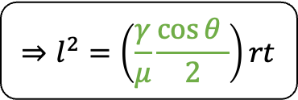
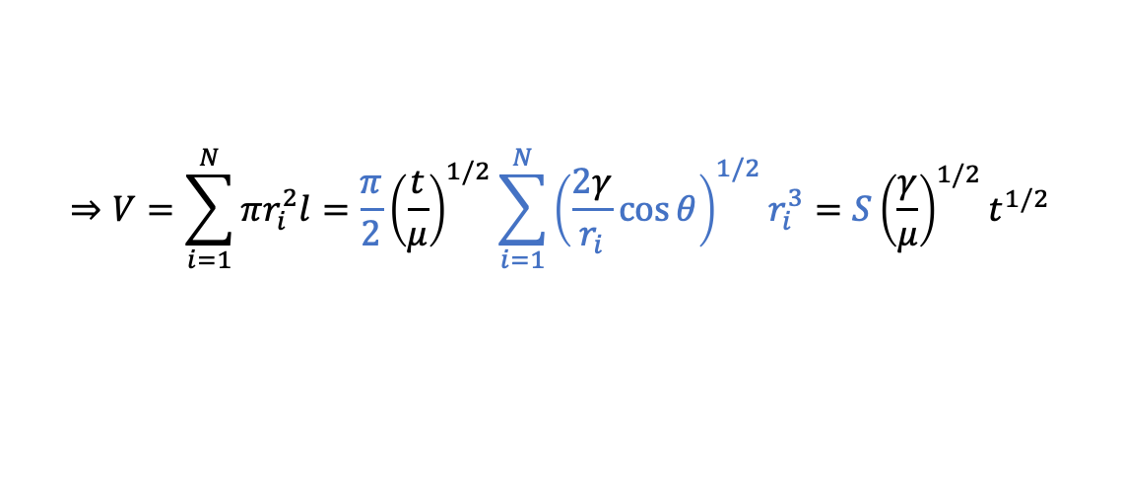
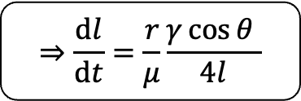
IMBIBITION AND DYNAMICS OF CAPILLARY FLOW
2
Theory
E. W. Washburn (1921) “The dynamics of capillary flow“
Penetrativity
$$⇒l^{2}=\left(\frac{γ}{μ}\frac{\cos{θ }}{2}\right)rt$$
„Lucas-Washburn Law“
$$⇒\frac{\text{d}l}{\text{d}t}=\frac{r}{μ}\frac{γ\cos{θ }}{4l}$$
Rate of Penetration
$$⇒V=\sum_{i=1}^{N}{πr_{i}^{2}l=\frac{π}{2}{\left(\frac{t}{μ}\right)}^{1/2}}\sum_{i=1}^{N}{{\left(\frac{2γ}{r_{i}}\cos{θ}\right)}^{1/2}r_{i}^{3}=S{\left(\frac{γ}{μ}\right)}^{1/2}t^{1/2}}$$

Slide 7
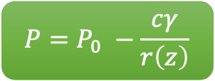
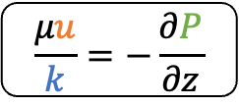


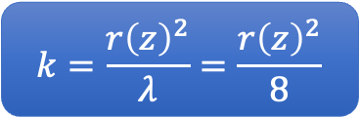
IMBIBITION IN GEOMETRIES WITH AXIAL VARIATIONS IN 3D
2
M. Reyssat, L. Courbin, E. Reyssat, and H. A. Stone (2008) “Imbibition in geometries with axial variations”
Theory
$$P=P_{0} −\frac{cγ}{r\left(z\right)}$$
Volumetric Flow Rate
$$Q=uπr{\left(z\right)}^{2}$$
$$\frac{μu}{k}=−\frac{∂P}{∂z}$$
Darcy Law
$$k=\frac{r{\left(z\right)}^{2}}{λ}=\frac{r{\left(z\right)}^{2}}{8}$$
Permeability
$$⇒\frac{8μQ}{πr{\left(z\right)}^{4}}=−\frac{∂P}{∂z}$$

Slide 8
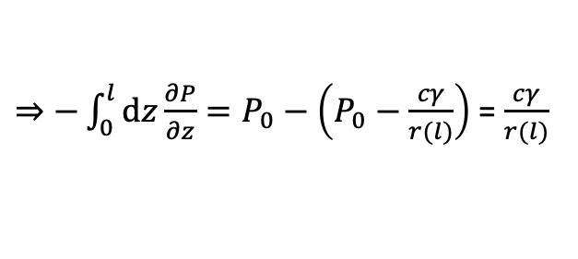
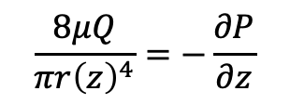
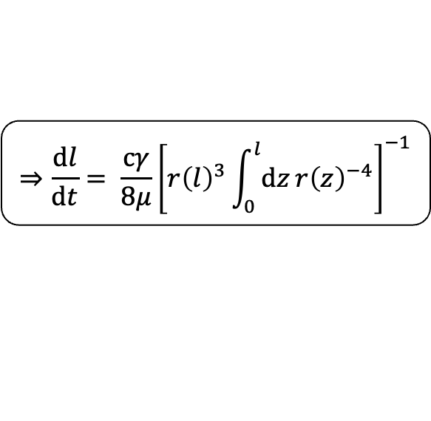
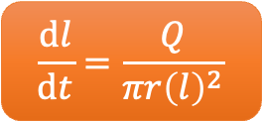
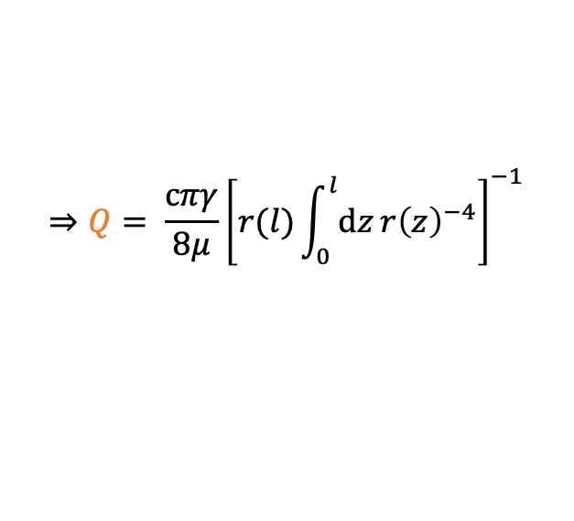
IMBIBITION IN GEOMETRIES WITH AXIAL VARIATIONS IN 3D
2
M. Reyssat, L. Courbin, E. Reyssat, and H. A. Stone (2008) “Imbibition in geometries with axial variations”
Theory
$$\frac{8μQ}{πr{\left(z\right)}^{4}}=−\frac{∂P}{∂z}$$
$⇒−\int_{0}^{l}{\text{d}z}\frac{∂P}{∂z}=P_{0}−\left(P_{0}−\frac{cγ}{r(l)}\right)$ = $\frac{cγ}{r(l)}$
$$\frac{\text{d}l}{\text{d}t}=\frac{Q}{πr{\left(l\right)}^{2}}$$
$$⇒Q= \frac{cπγ}{8μ}{\left[r(l)\int_{0}^{l}{\text{d}z}r{\left(z\right)}^{−4}\right]}^{−1}$$
$$⇒\frac{\text{d}l}{\text{d}t}= \frac{cγ}{8μ}{\left[r{\left(l\right)}^{3}\int_{0}^{l}{\text{d}z}r{\left(z\right)}^{−4}\right]}^{−1}$$
General Imbibition Equation for Invasion into structured Solid in 3D

Slide 9
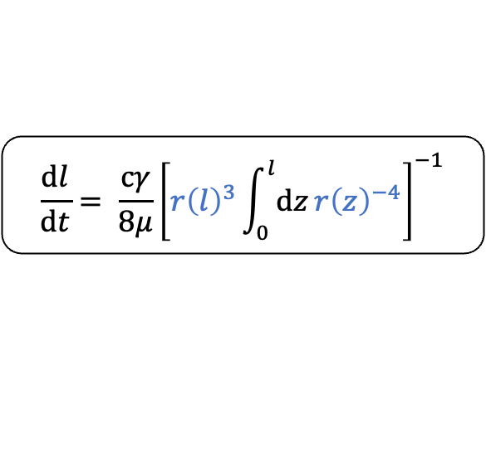
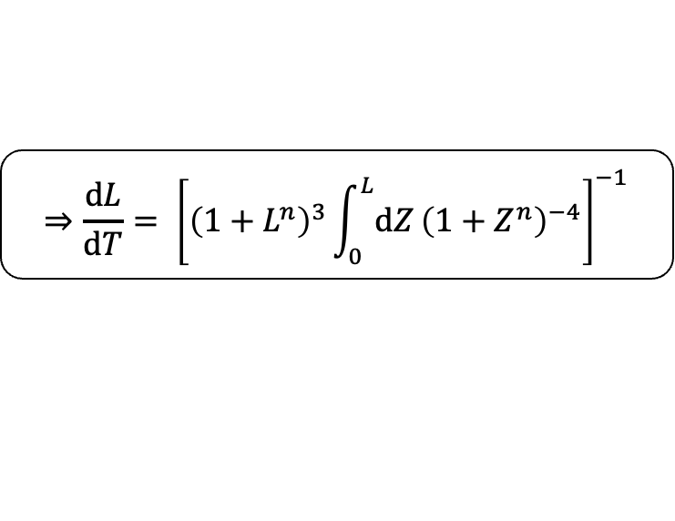
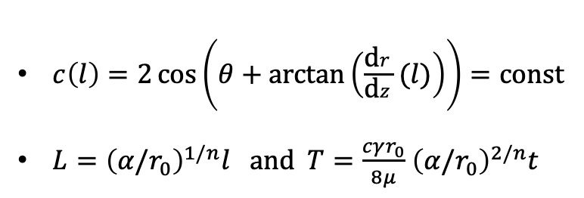
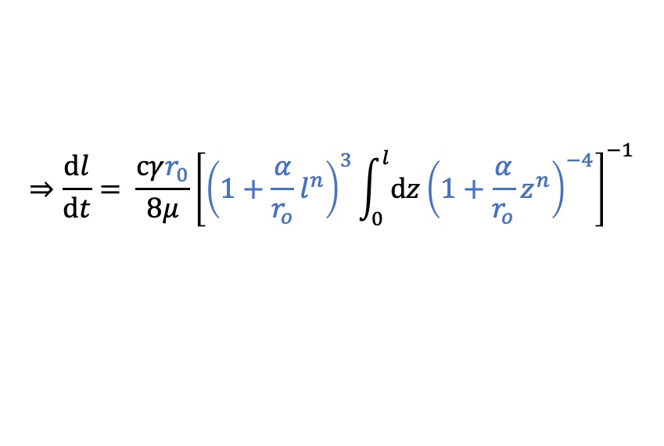

IMBIBITION IN GEOMETRIES WITH AXIAL VARIATIONS IN 3D
2
M. Reyssat, L. Courbin, E. Reyssat, and H. A. Stone (2008) “Imbibition in geometries with axial variations”
Theory
Power-Law shaped Structure
$$\frac{\text{d}l}{\text{d}t}= \frac{cγ}{8μ}{\left[r{\left(l\right)}^{3}\int_{0}^{l}{\text{d}z}r{\left(z\right)}^{−4}\right]}^{−1}$$
$$r\left(z\right)=r_{0}+αz^{n}$$
$$⇒\frac{\text{d}l}{\text{d}t}= \frac{cγr_{0}}{8μ}{\left[{\left(1+\frac{α}{r_{o}}l^{n}\right)}^{3}\int_{0}^{l}{\text{d}z}{\left(1+\frac{α}{r_{o}}z^{n}\right)}^{−4}\right]}^{−1}$$
$$⇒\frac{\text{d}L}{\text{d}T}= {\left[{\left(1+L^{n}\right)}^{3}\int_{0}^{L}{\text{d}Z}{\left(1+Z^{n}\right)}^{−4}\right]}^{−1}$$
$c\left(l\right)=2\cos\left(θ+\text{arctan}\left(\frac{\text{d}r}{\text{d}z}(l)\right)\right)=\text{const}$
$L={\left(α/r_{0}\right)}^{1/n}l \text{and} T=\frac{cγr_{0}}{8μ}$ ${\left(α/r_{0}\right)}^{2/n}t$

Slide 10
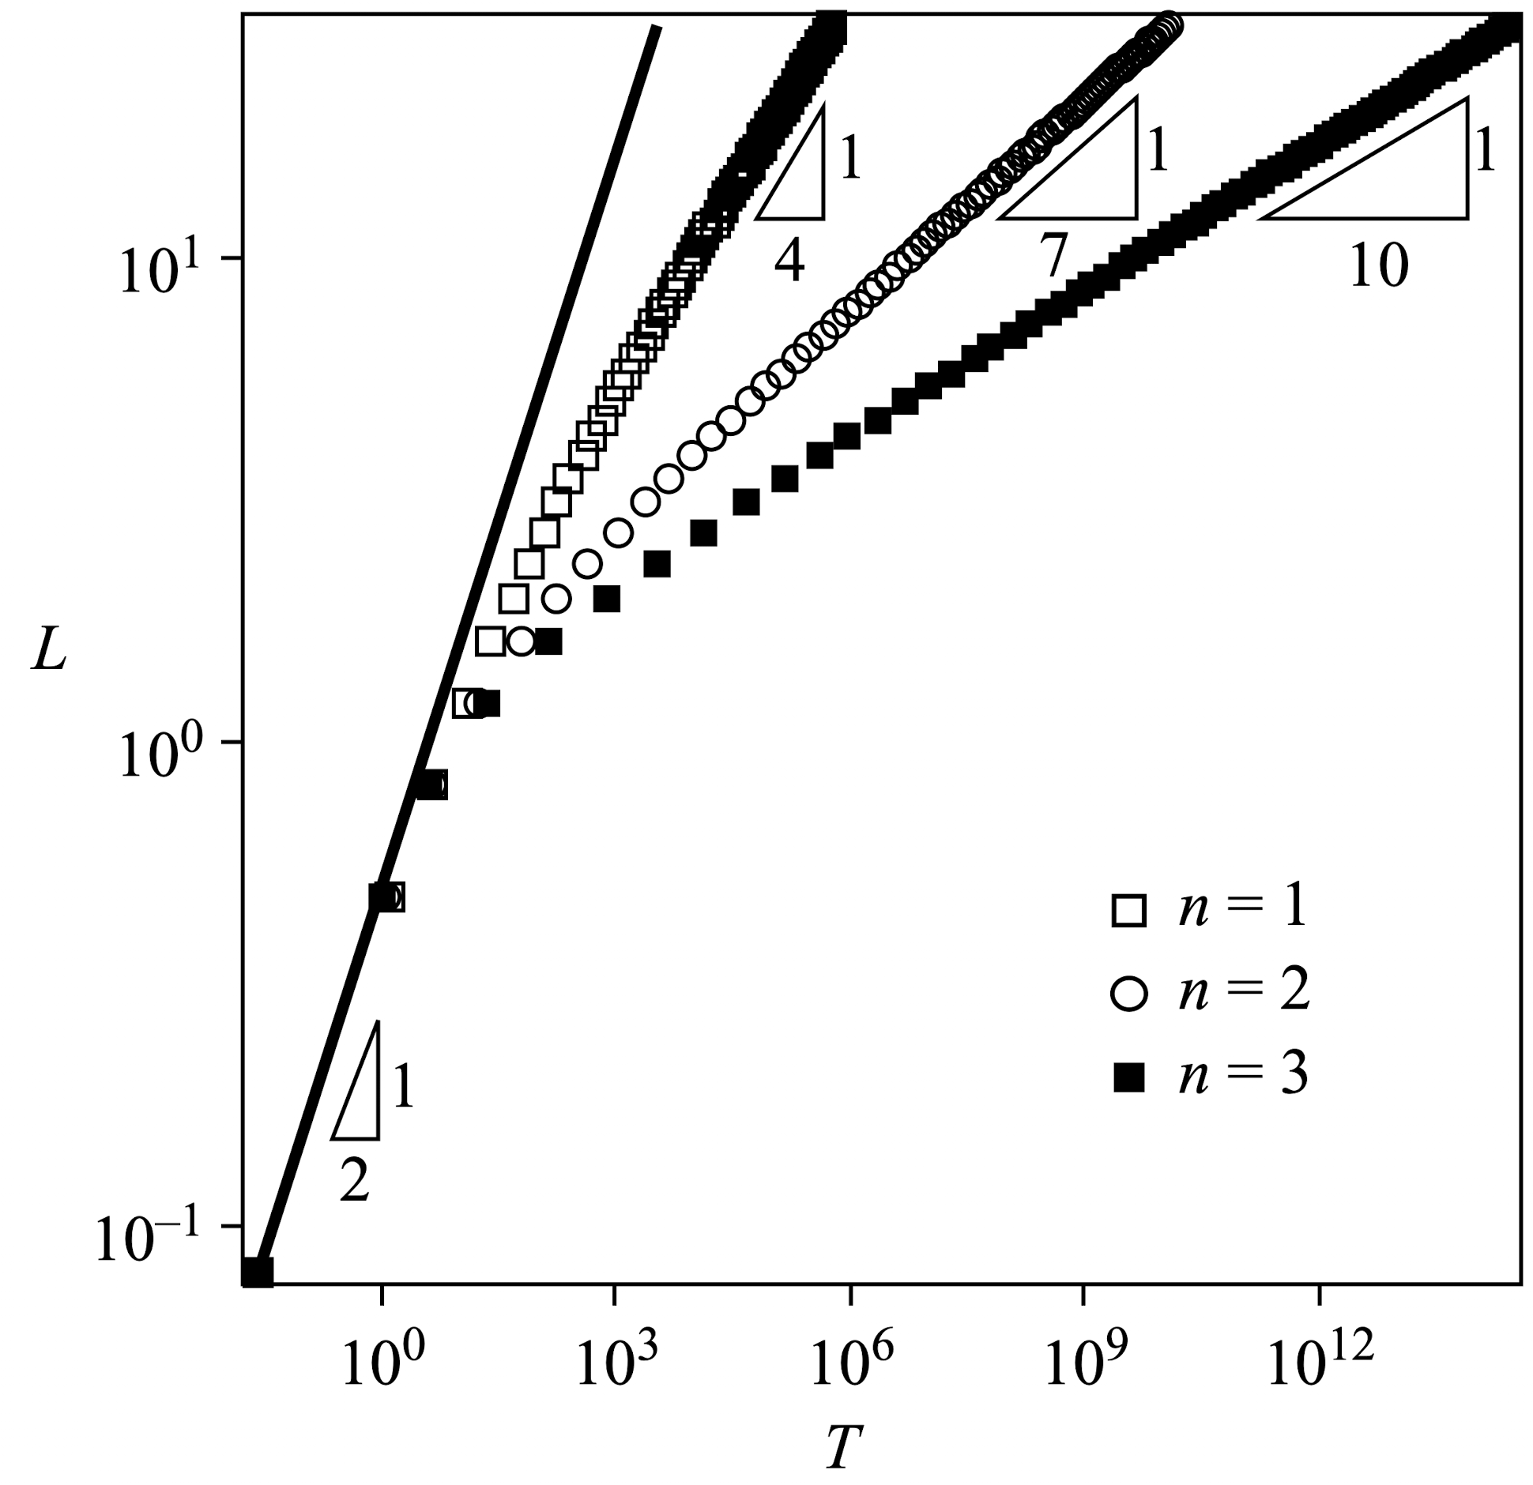
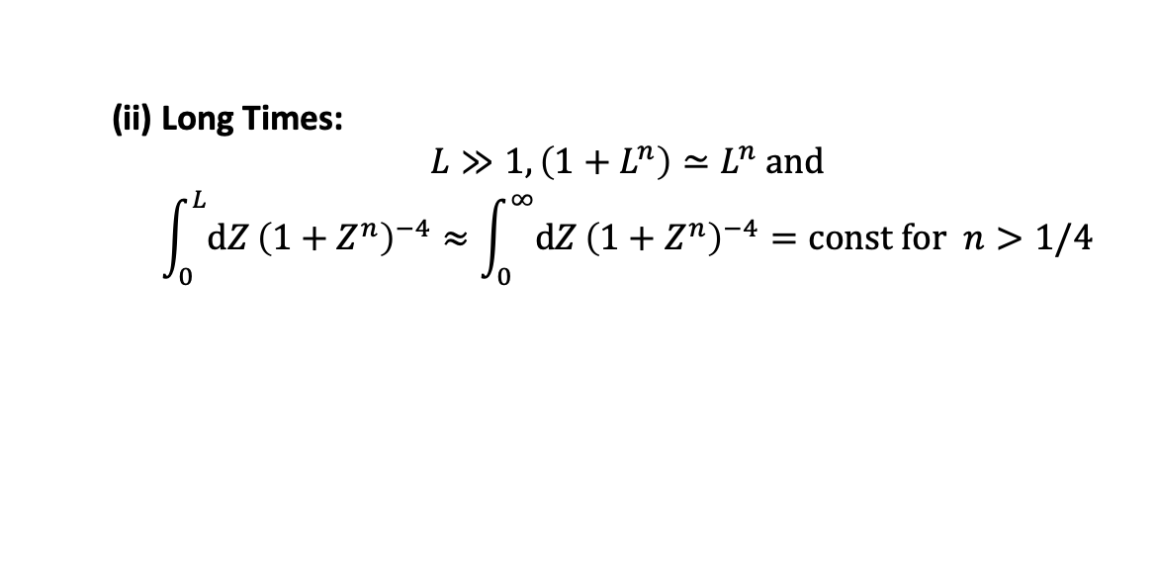
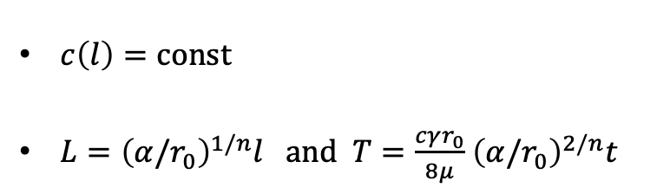
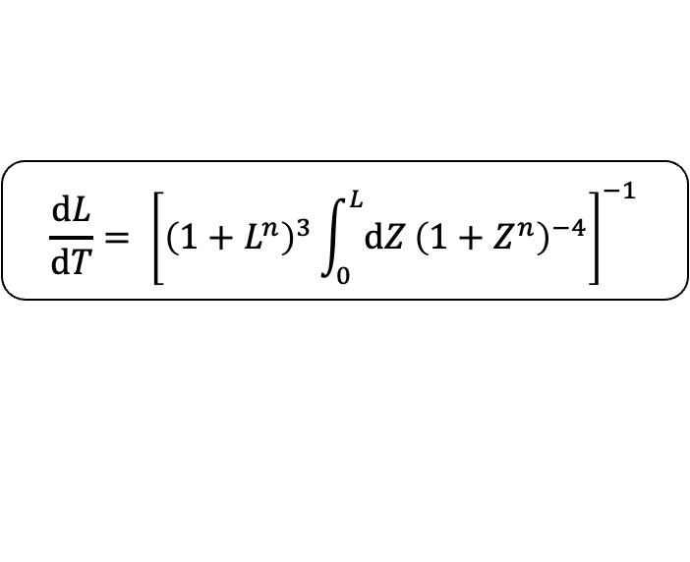
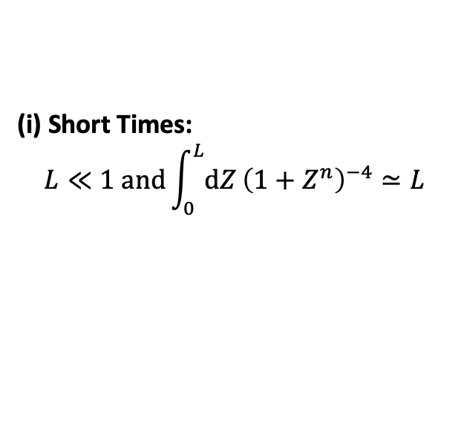
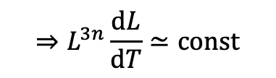
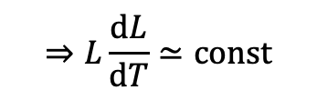
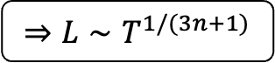
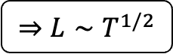
IMBIBITION IN GEOMETRIES WITH AXIAL VARIATIONS IN 3D
2
M. Reyssat, L. Courbin, E. Reyssat, and H. A. Stone (2008) “Imbibition in geometries with axial variations”
Theory
$$\frac{\text{d}L}{\text{d}T}= {\left[{\left(1+L^{n}\right)}^{3}\int_{0}^{L}{\text{d}Z}{\left(1+Z^{n}\right)}^{−4}\right]}^{−1}$$
(I) $n=0 \left(r\left(z\right)=r_{0}\right): ⇒L∼T^{1/2}$ „Lucas-Washburn Law“
(II) $n≥1:$
(i) Short Times:
$$L≪1 \text{and}\int_{0}^{L}{\text{d}Z}{\left(1+Z^{n}\right)}^{−4}≃L$$
$$⇒L\frac{\text{d}L}{\text{d}T}≃\text{const}$$
$$⇒L∼T^{1/2}$$
(ii) Long Times:
$$L≫1,\left(1+L^{n}\right)≃L^{n} \text{and}$$
$$\int_{0}^{L}{\text{d}Z}{\left(1+Z^{n}\right)}^{−4}≈\int_{0}^{∞}{\text{d}Z}{\left(1+Z^{n}\right)}^{−4}=\text{const} \text{for} n>1/4$$
$c\left(l\right)=\text{const}$
$L={\left(α/r_{0}\right)}^{1/n}l \text{and} T=\frac{cγr_{0}}{8μ}$ ${\left(α/r_{0}\right)}^{2/n}t$
$$⇒L^{3n}\frac{\text{d}L}{\text{d}T}≃\text{const}$$
$$⇒L∼T^{1/(3n+1)}$$

Slide 11
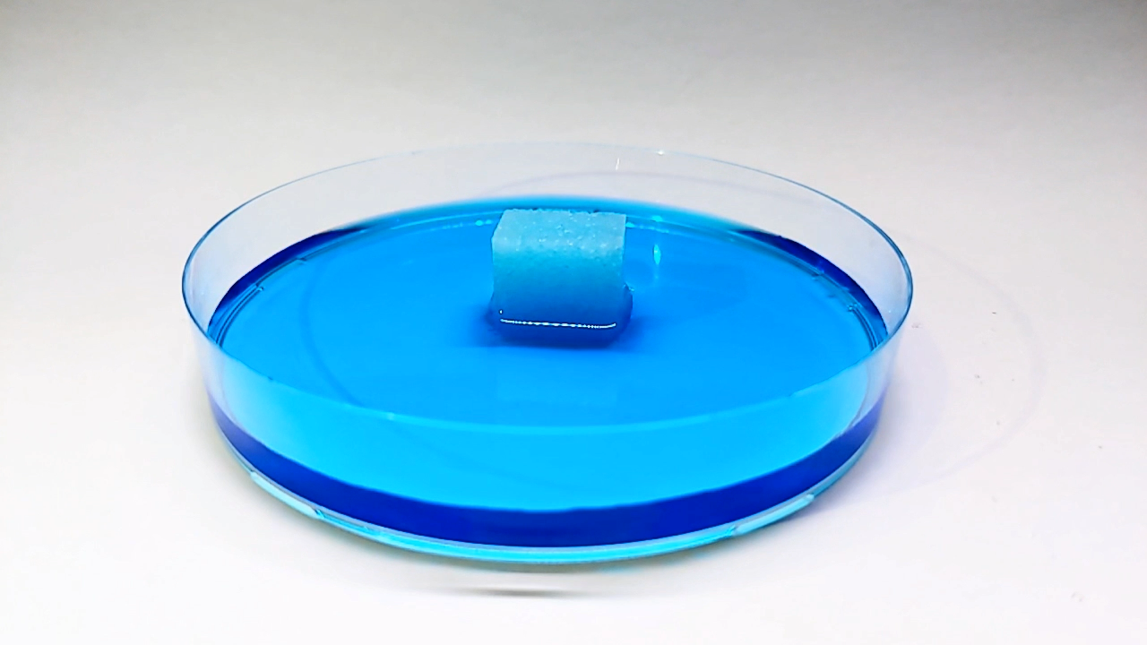
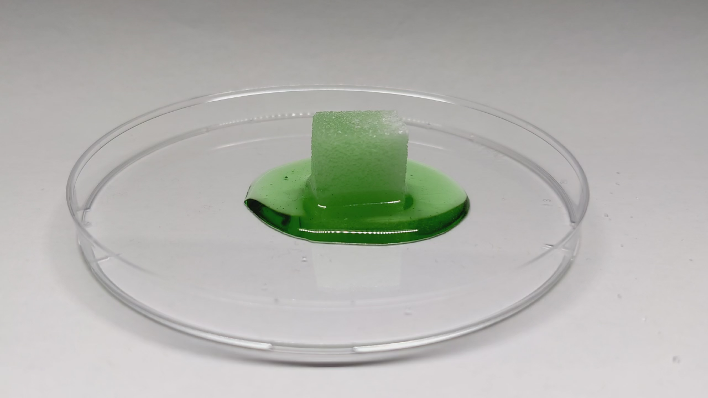
IMBIBITION WITH SUGAR IN WATER AND GLYCERIN
3
Experiments
Water
Glycerin
Slowed down with 1s = 0.125s
Sped up with 1s = 30s

Slide 12












IMBIBITION WITH FILTER PAPER IN WATER
3
F. Dullien (1991) “Porous Media – Fluid Transport and Pore Structure”
Experiments
Sped up with 1s = 10s
$$l$$
$$t$$

Slide 13

IMBIBITION WITH FILTER PAPER IN WATER
3
F. Dullien (1991) “Porous Media – Fluid Transport and Pore Structure”
Experiments

Slide 14
IMBIBITION WITH FILTER PAPER IN WATER
3
F. Dullien (1991) “Porous Media – Fluid Transport and Pore Structure”
Experiments

Slide 15



IMBIBITION: WHAT WE LEARNED TODAY?
4
Conclusion
Imbibition is an important process in nature and industry
Capillarity-driven imbibition can be described by „Lucas-Washburn Law“
Varying the geometry of the capillary (3D) results in two time regimes:
Experiments with coffee filter paper proofs the „Lucas-Washburn Law“
$$l^{2}=\left(\frac{γ}{μ}\frac{\cos{θ }}{2}\right)rt$$
$$L∼T^{1/2}$$
$$L∼T^{1/(3n+1)}$$
Short times
Long times

Slide 16







IMBIBITION IN GEOMETRIES WITH AXIAL VARIATIONS IN 2D
5
M. Reyssat, L. Courbin, E. Reyssat, and H. A. Stone (2008) “Imbibition in geometries with axial variations”
Appendix
$$P=P_{0} −\frac{cγ}{r\left(z\right)}$$
$$⇒\frac{\text{d}l}{\text{d}t}= \frac{cγ}{3μ}{\left[r{\left(l\right)}^{2}\int_{0}^{l}{\text{d}z}r{\left(z\right)}^{−3}\right]}^{−1}$$
Volumetric Flow Rate
$$⇒\frac{\text{d}L}{\text{d}T}= {\left[{\left(1+L^{n}\right)}^{2}\int_{0}^{L}{\text{d}Z}{\left(1+Z^{n}\right)}^{−3}\right]}^{−1}$$
$$Q=2ur(z)$$
$$\frac{μu}{k}=−\frac{∂P}{∂z}$$
Darcy Law
$$k=\frac{r{\left(z\right)}^{2}}{λ}=\frac{r{\left(z\right)}^{2}}{3}$$
$$L∼T^{1/2}$$
$$L∼T^{1/(2n+1)}$$
Permeability
Short times
Long times
$$⇒\frac{3μQ}{πr{\left(z\right)}^{3}}=−\frac{∂P}{∂z}$$
$c\left(l\right)=\text{const}$
$L={\left(α/r_{0}\right)}^{1/n}l \text{and} T=\frac{cγr_{0}}{8μ}$ ${\left(α/r_{0}\right)}^{2/n}t$

Slide 17

WHY $c\left(l\right)$ IS CONSTANT?
5
M. Reyssat, L. Courbin, E. Reyssat, and H. A. Stone (2008) “Imbibition in geometries with axial variations”
Appendix

Slide 18



IMBIBITION EXPERIMENTS WITH VYCOR GLASS
5
S. Gruener et al. (2012) “Anomalous front broadening during spontaneous imbibition in a matrix with elongated pores”
Appendix

Slide 19


OUTTAKES
5
Appendix

